Slide 1
Do we need fast charging in urban areas ?
International Conference on Mobility Challenges
08/12/2022
Marc-Olivier METAIS
marc-olivier.metais@centralesupelec.fr

Slide 2
Do we need fast charging in urban areas ?
1. Background on EV and charging infrastructure
2. Insights from the literature
3. A rational deployment model
4. Conclusion

Slide 3
Do we need fast charging in urban areas ?
1. Background on EV and charging infrastructure
1.1. EVs
1.2. Charging infrastructure
2. Insights from the literature
3. A rational deployment model
4. Conclusion

Slide 4
1.1. A bit of background on EVs
ICE Vehicle
~15% of global GHG emissions^{[1]}
~40% of French GHG emissions
Acoustic pollution
Electric vehicle
No tailpipe emission
Reduced particulate emissions
Reduced noise
Two main barriers for EV adoption^{[2]}
Bigger batteries
Price
Range anxiety
Better charging infrastructure
[1] European Environment Agency. Greenhouse gas emissions from transport in Europe, 2019.
[2] Nigel Berkeley, David Jarvis, and Andrew Jones. Analysing the take up of battery electric vehicles: An investigation of barriers amongst drivers in the UK

Slide 5
1.3. Charging infrastructure
≠ types (highways, city streets…)
≠ traffic
≠ charging speed
≠ costs
covers
travels on
≠ needs
≠ behaviours
≠ battery capacity
≠ vehicles
Transportation network
provides power to
needs
Charging infrastructure
EV user
provides power to
(optional)
provides power to
Power grid
How to deploy a charging infrastructure?
Home charging

Slide 6
Do we need fast charging in urban areas ?
1. Background on EV and charging infrastructure
2. Insight from the literature
2.1. Deploying a charging infrastructure
2.2. The chicken and egg problem
3. A rational deployment model
4. Conclusion

Slide 7
2.1. Deploying a charging infrastructure : what does the literature says ?
ETC, ETC….

Slide 8
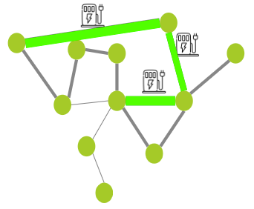
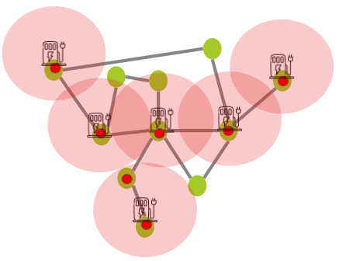
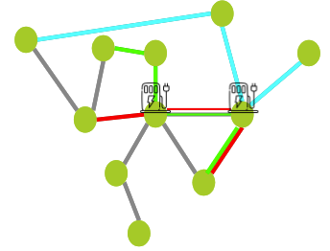
2.1. Deploying a charging infrastructure : what does the literature says ?
More precisely
Different goals
Different approaches
Economic considerations (cost, profitability...)
Flow capture (or path-based)
Technical considerations (electric grid, security…)
Land coverage (or node-based)
Interests of the different actors (appeal effect...)
Users considerations (ease of use, lost time…)
Event capture (or tour-based)

Slide 9
2.1. Deploying a charging infrastructure : what does the literature says ?
More precisely
Different goals
Different approaches
Economic considerations (cost, profitability...)
Flow capture (or path-based)
Technical considerations (electric grid, security…)
Land coverage (or node-based)
Interests of the different actors (appeal effect...)
Users considerations (ease of use, lost time…)
Event capture (or tour-based)

Slide 10
2.2. The chicken and egg problem
?
Charging infrastructure must take the lead in this two-sided market development
Charging infrastructure or EVs first?

Slide 11
Do we need fast charging in urban areas ?
1. Background on EV and charging infrastructure
2. Insights from the literature
3. A rational deployment model
3.1. Principle of the model
3.2. Score calculation
3.3. MATSim
3.4. Firsts results
3.5. Limits of the model
4. Conclusion

Slide 12
3.1. Model principle
Starting point :
The development of recharging infrastructure must support the democratization of electric vehicles.
What we need
A location model integrating the temporal aspect of infrastructure deployment, users-centered, adapted to a mixed territory
What our model does
Pre-selects candidate locations for charging stations
Assigns a score to each location
Places stations in order to maximize the global score
Recalculates location scores with the new data
And so it goes, until we run out of budget

Slide 13
3.2. Score assignation
Score calculated according to 5 criteria
Parking duration
Number of parking events
Number of distinct vehicles
State of charge of vehicles
Land coverage
Constraints
Cost
Construction cost
Electric grid

Slide 14
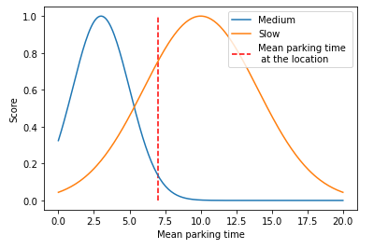
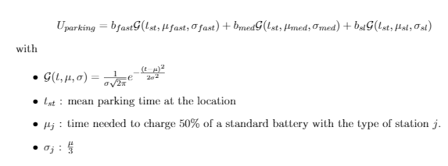
3.2. Score calculation
Score calculated according to 5 criteria
Parking duration
Number of parking events
Number of distinct vehicles
State of charge of vehicles
Land coverage
Choose the right type of station at the location
(medium, slow, fast)

Slide 15
3.2. Score calculation
Score calculated according to 5 criteria
Parking duration
Number of parking events
Number of distinct vehicles
State of charge of vehicles
Land coverage
Determine the number of vehicles to be served at the location

Slide 16
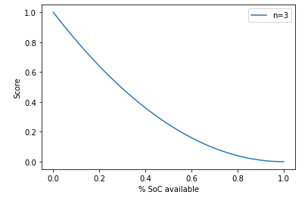
3.2. Score calculation
Score calculated according to 5 criteria
Number of parking events
Number of distinct vehicles
State of charge of vehicles
Land coverage
Parking duration
Determine the utility of placing a charging station at the location according to the EV driving range

Slide 17
3.2. Score calculation
Score calculated according to 5 criteria
Parking duration
Number of parking events
Number of distinct vehicles
State of charge of vehicles
Land coverage
Minimize inaccessible areas

Slide 18
3.3. Data and tests : MATSim
MATSim : a multi-agent simulation framework for transport
Allows to collect data on agent’s behaviour
Allows to simulate the response of agents to the addition of one or more stations
Ex : Berlin simulation
Notes:
Temporal aspect : you don’t build your infrastructure at once, and the infrastructure influence the EV adoption, and vice versa the EV adoption influence infrastructure deployment
User centered : users are the ones that decide if they switch to EV or not
Mixed territory : you don’t want to use your EV only in specific conditions, it must can be a main vehicle

Slide 19
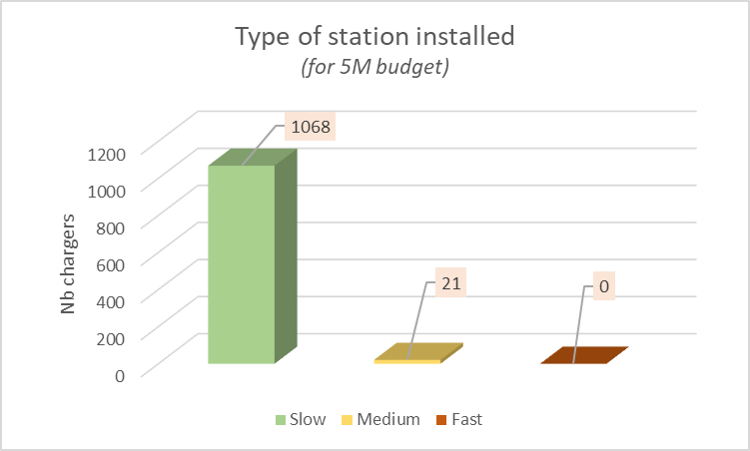
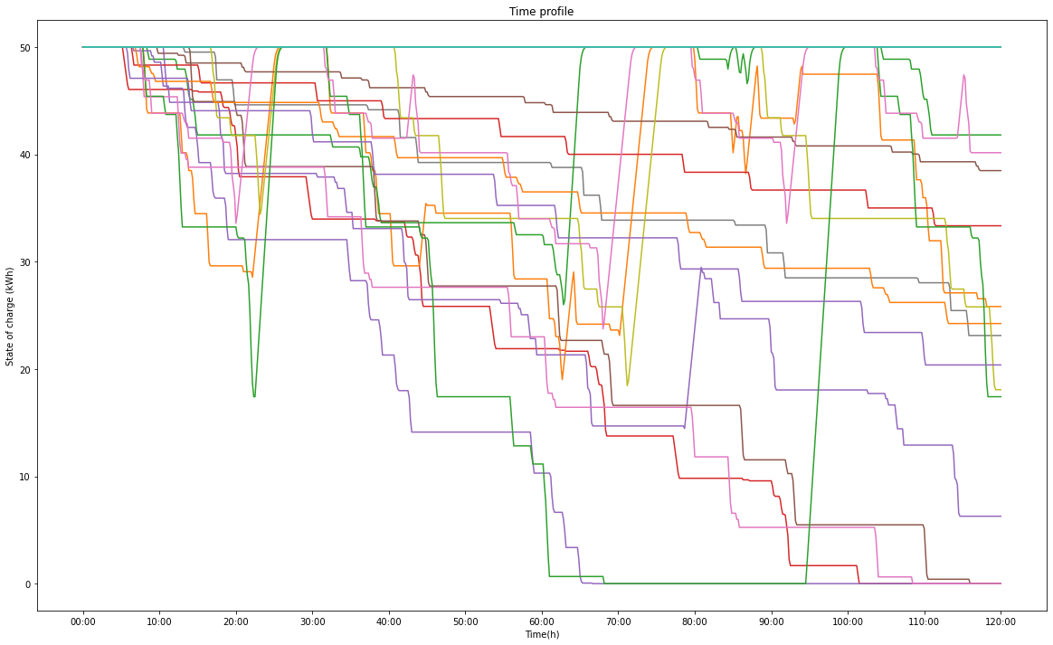
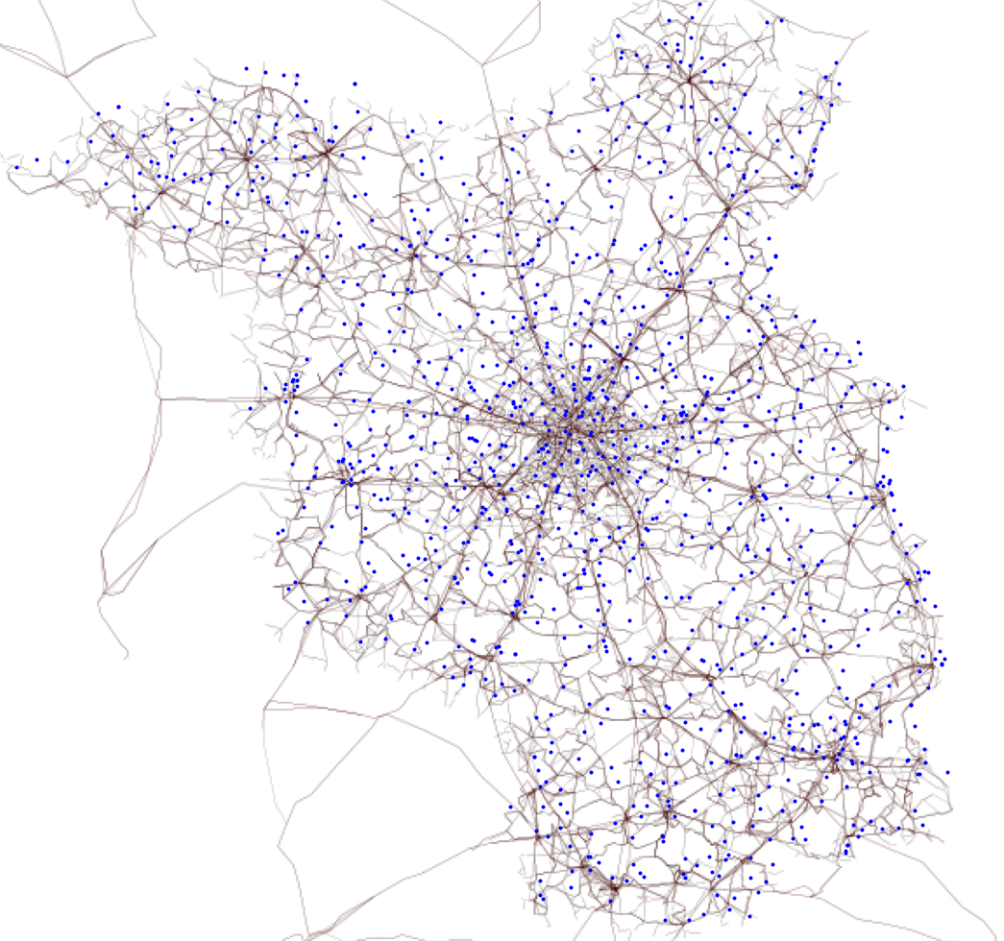
3.4. Main results
Slow charging station are more cost-efficient
Most of the vehicles never run out of battery
Charging stations are rather scattered than clustered

Slide 20
Do we need fast charging in urban areas ?
1. Background on EV and charging infrastructure
2. Insights from the literature
3. A rational deployment model
4. Conclusion

Slide 21
4. Conclusion
EVs and charging infrastructure
EVs and charging infrastructure form a two-sided market
The first step toward a transition from ICE to EVs have to come from the public infrastructure side
Charging infrastructure planning
Must be over time with a coherent agenda
Must take into account the users behaviour
Main results
It’s possible to have EVs as convenient as (or even more than) ICEV with the right deployment model
The slowest and least expensive stations are more cost effective
Fast charging stations should be reserved for highways

Slide 22
Thank you for your attention !

